Slide 1
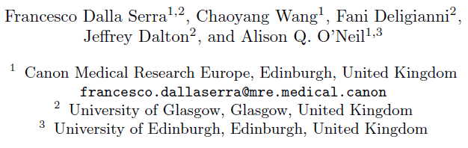
Finding-Aware Anatomical Tokens for Chest X-Ray Automated Reporting

Slide 2
Motivation
A radiology report provides a detailed description and interpretation of medical scan findings, including their location and appearance.
Recent methods employ CNN-Transformer architectures, encoding CXRs with CNNs and using a Transformer language model to generate reports. This information is crucial for diagnosis and treatment decisions.
However, these generated reports often exhibit realistic style but suffer from accuracy issues, such as hallucinating additional findings or misrepresenting abnormal regions as normal.
-They investigate whether replacing the image-level tokens with local tokens – corresponding to anatomical structures – can improve the clinical accuracy of the generated reports.

Slide 3
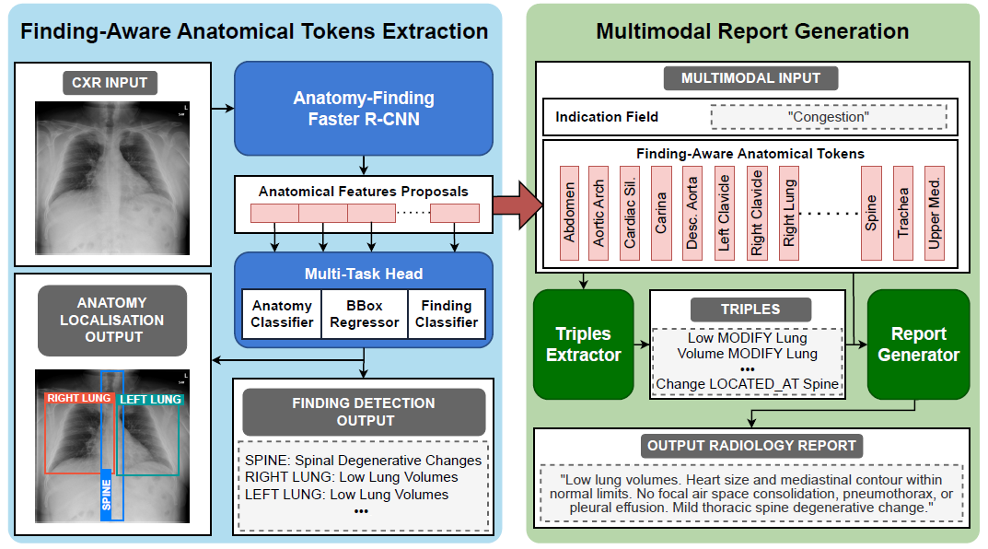
Methods
Finding-Aware Anatomical Token Extraction + Multimodal Report Generation

Slide 4
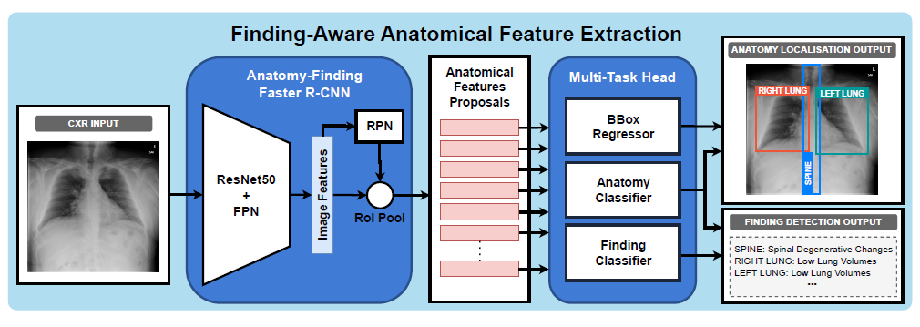
Finding-Aware Anatomical Token Extraction
-finding detection + anatomy localisation

Slide 5
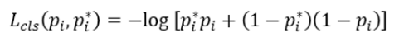
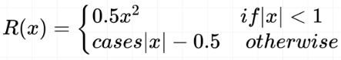
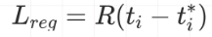
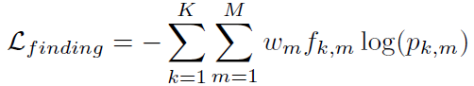
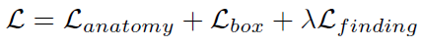
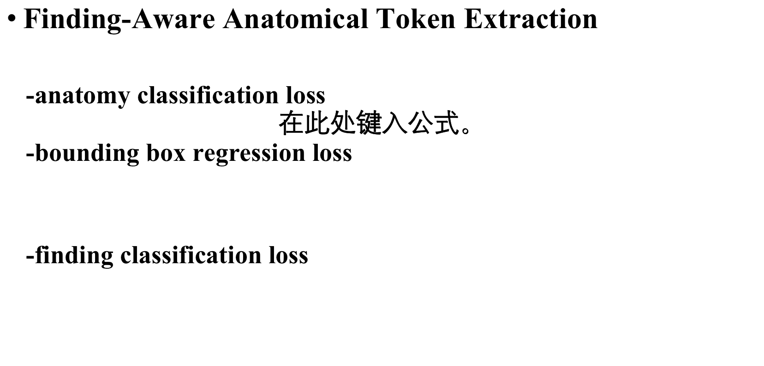
Finding-Aware Anatomical Token Extraction
-anatomy classification loss
-bounding box regression loss
-finding classification loss

Slide 6
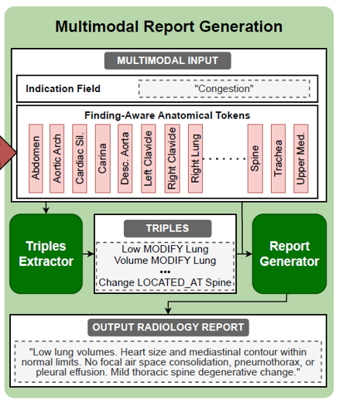
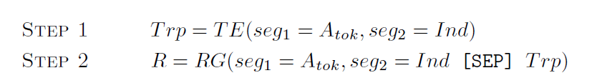
Multimodal Report Generation
-Triples Extracter
RadGraph sciSpaCy
-Report Generator

Slide 7
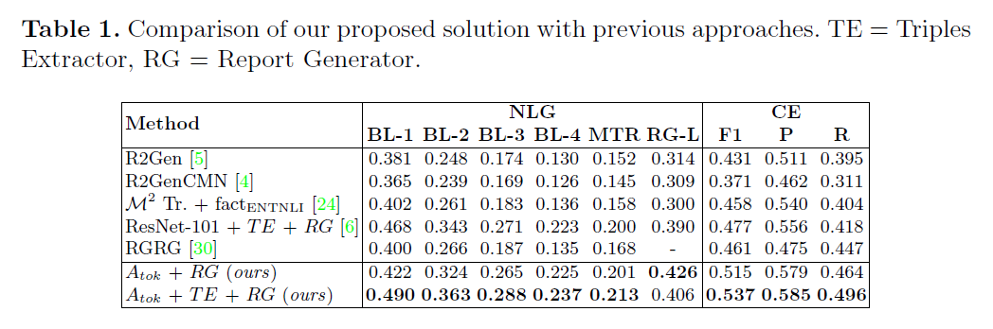
Experiments
Dataset
-Chest ImaGenome(derived from MIMIC-CXR, extended with additional automatically extracted annotations)
-MIMIC-CXR
Results

Slide 8
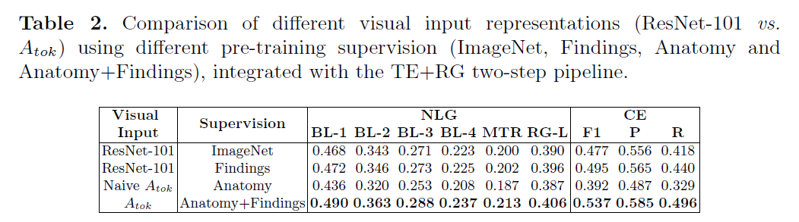
Experiments
Ablation Study

Slide 9
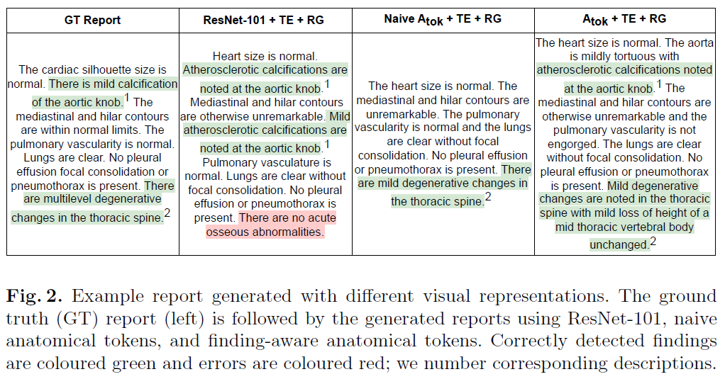
Experiments
Ablation Study

Slide 10
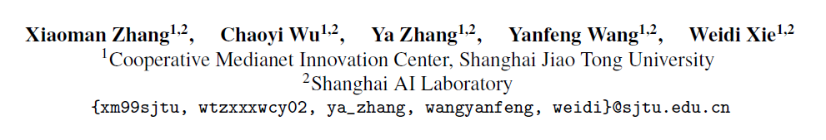
Knowledge-enhanced Visual-Language Pre-training on Chest Radiology Images

Slide 11
Motivation
Foundation models , such as, BERT, GPT and CLIP have shown great promise on feature transfer and generalisation to a wide spectrum of downstream tasks, for example, in natural language processing or computer vision.
Due to the requirement for fine-grained recognition in medical tasks (i.e., the clues for medical diagnosis often lie in subtle and regional signals), as well as the abstractness of many complex and professional medical terminologies, the development of foundation models in medical domains has been largely lagged behind
-They aim to build a foundation model for chest X-rays by training on paired images and reports

Slide 12
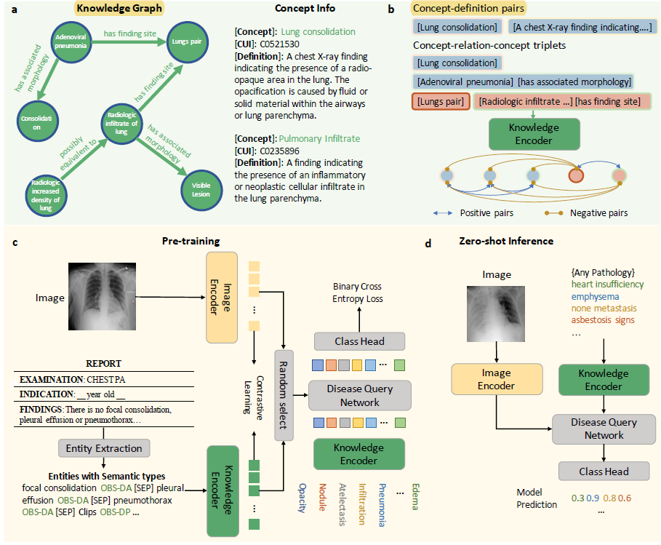
Methods
Framework

Slide 13
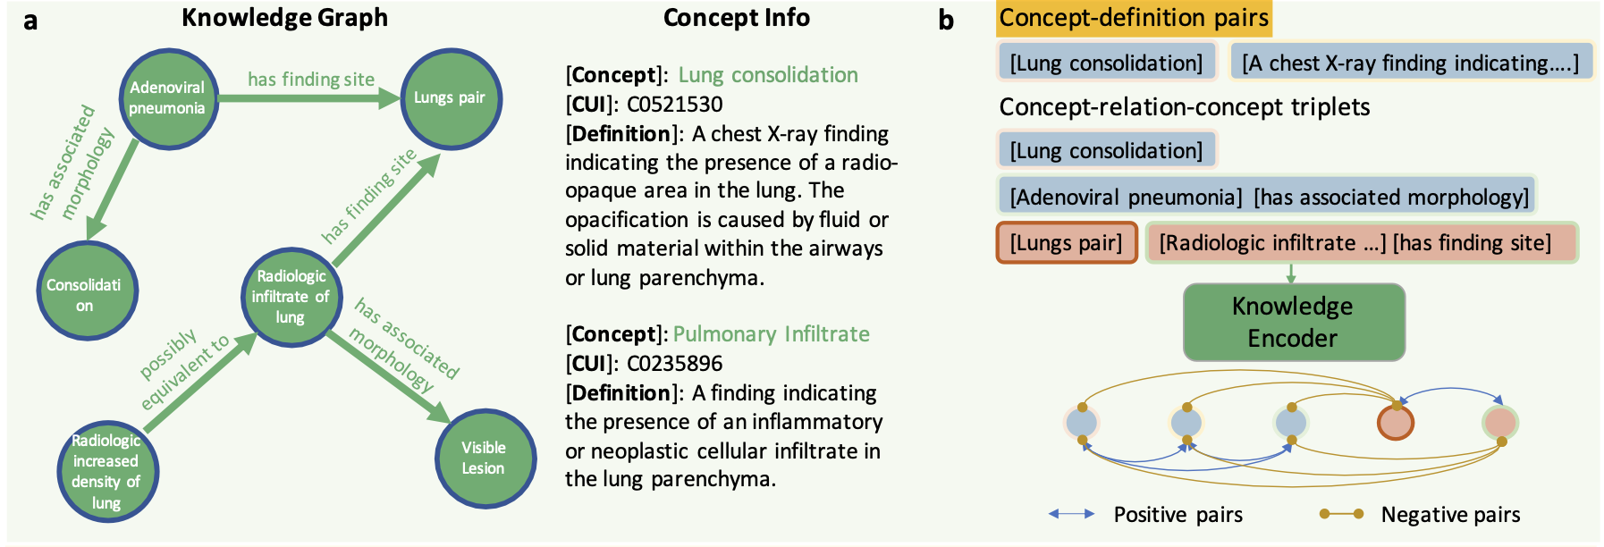
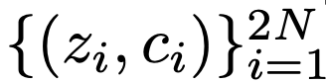
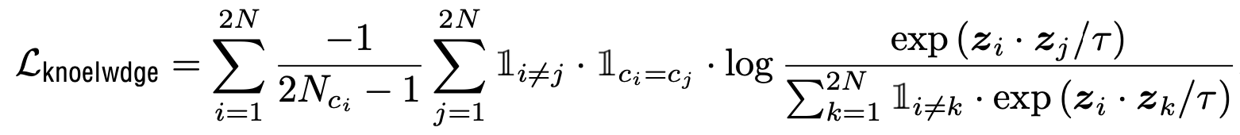
Methods
Knowledge encoder
each mini-batch:
Loss:

Slide 14
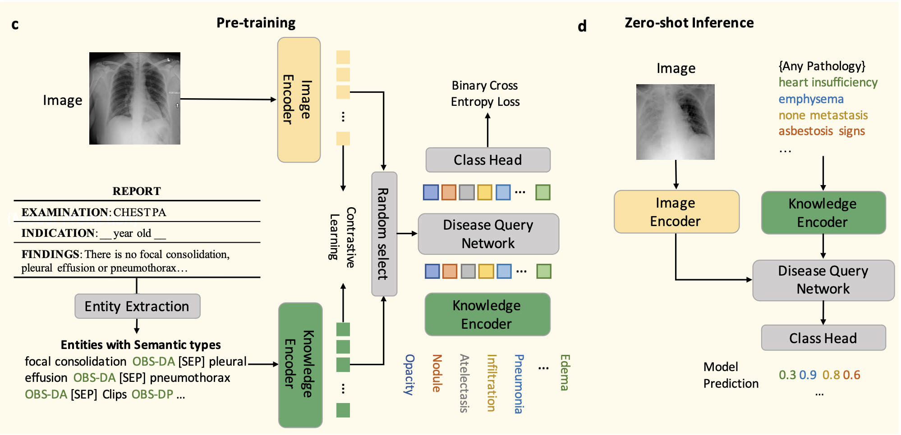
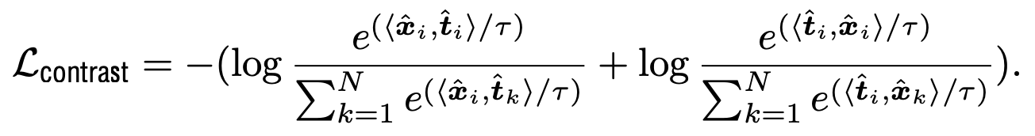
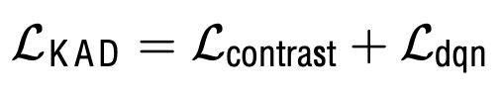
Methods
Knowledge-guided visual representation learning

Slide 15
Experiments
Domain-specific Knowledge
- UMLS Knowledge Graph.
- Entity Extraction: heuristicrules, RadGraph, or ChatGPT.For example, sentence “There is no consolidation, effusion, or pneumothorax.” will be converted into {consolidation, absent, [SEP], effusion, absent, [SEP], pneumothorax, absent}
Dataset
- MIMIC-CXR
- CheXpert (Stanford Hospital)
- PadChest (San Juan Hospita)
- NIH ChestX-ray (National Institutes of Health)
- CheXDet10 (National Institutes of Health)

Slide 16
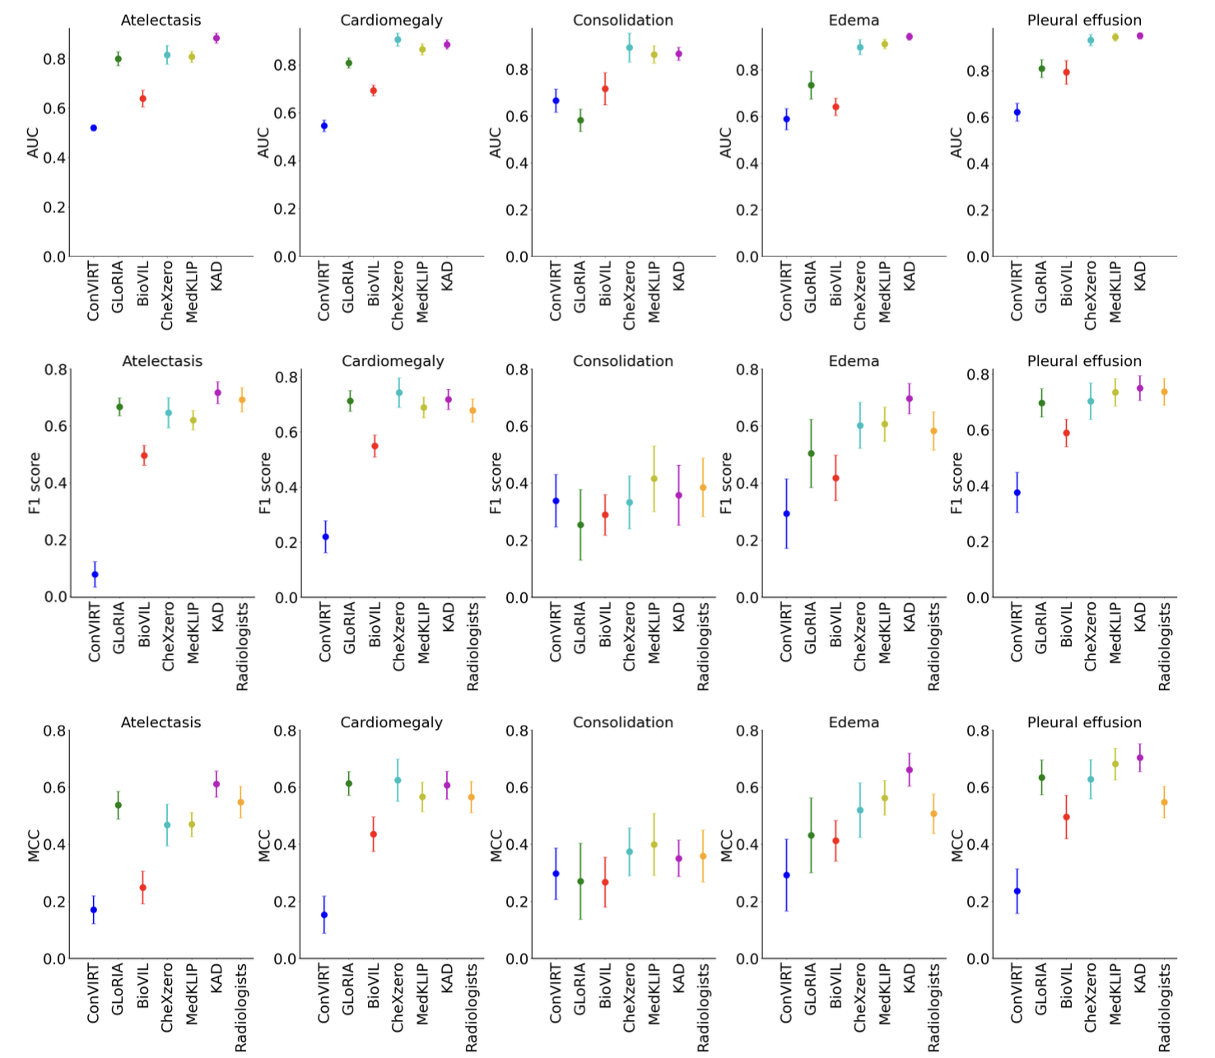
Experiments
Comparisons of proposed KAD with SOTA medical image-text pre-training models and three board-certified radiologists on five competition pathologies in CheXpert dataset.

Slide 17
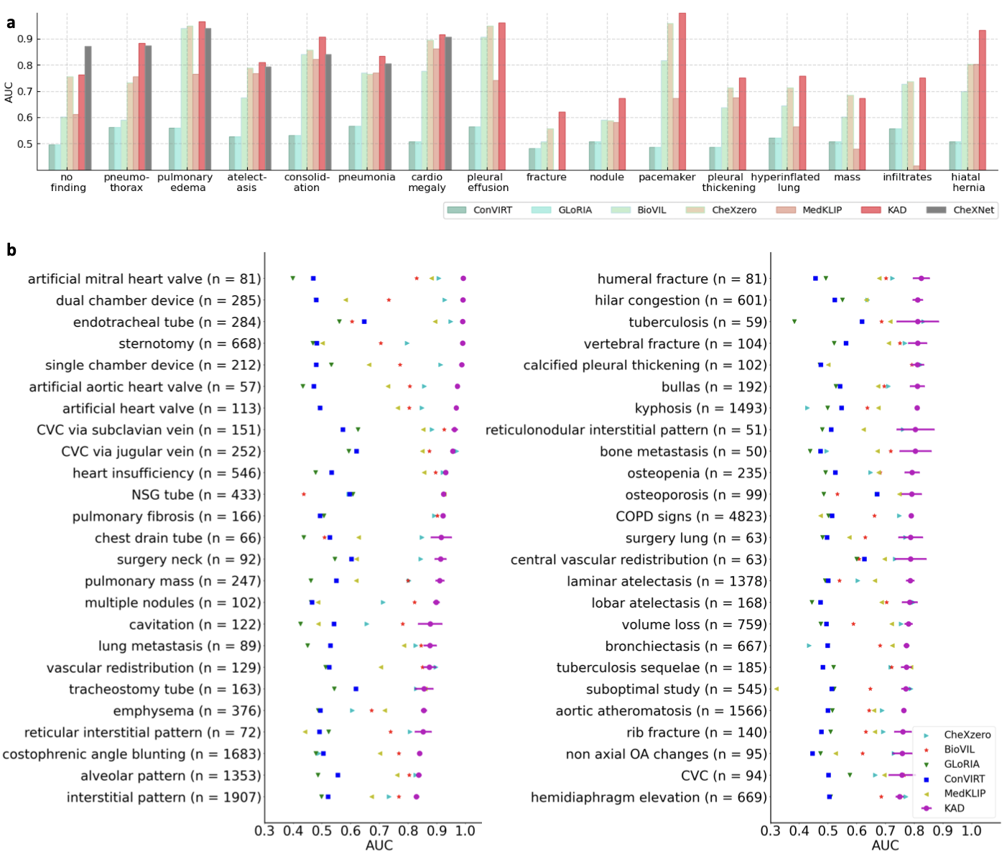
Experiments
Comparison of KAD with SOTA medical image-text pre-training models under zero-shot setting on radiographic findings or diagnoses in the PadChest dataset.

Slide 18
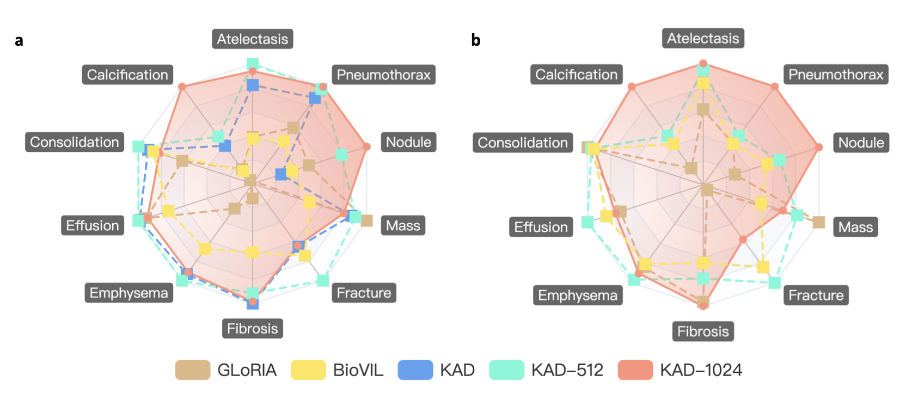
Experiments
Comparisons of proposed KAD with SOTA medical image-text pre-training models on ChestX-Det10 dataset.

Slide 19
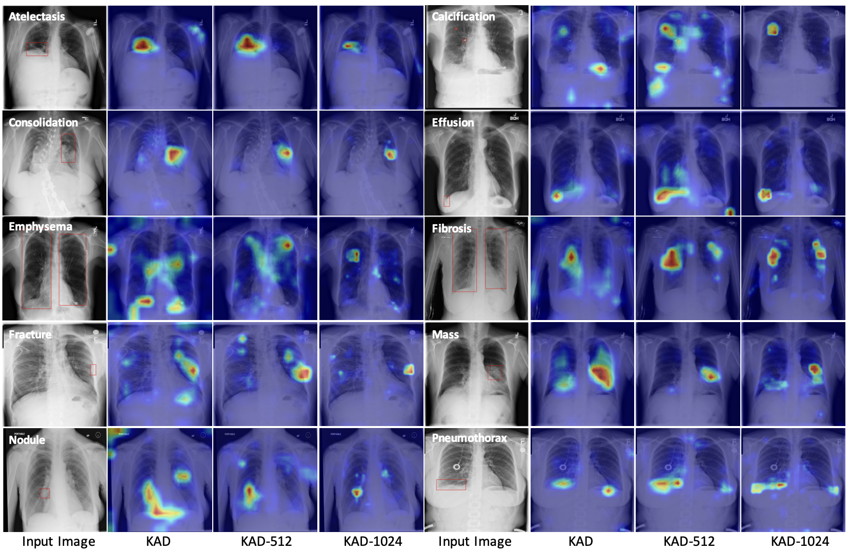
Experiments
the original image (left) and attention maps generated from KAD, KAD-512 and KAD-1024.

